Slide 1
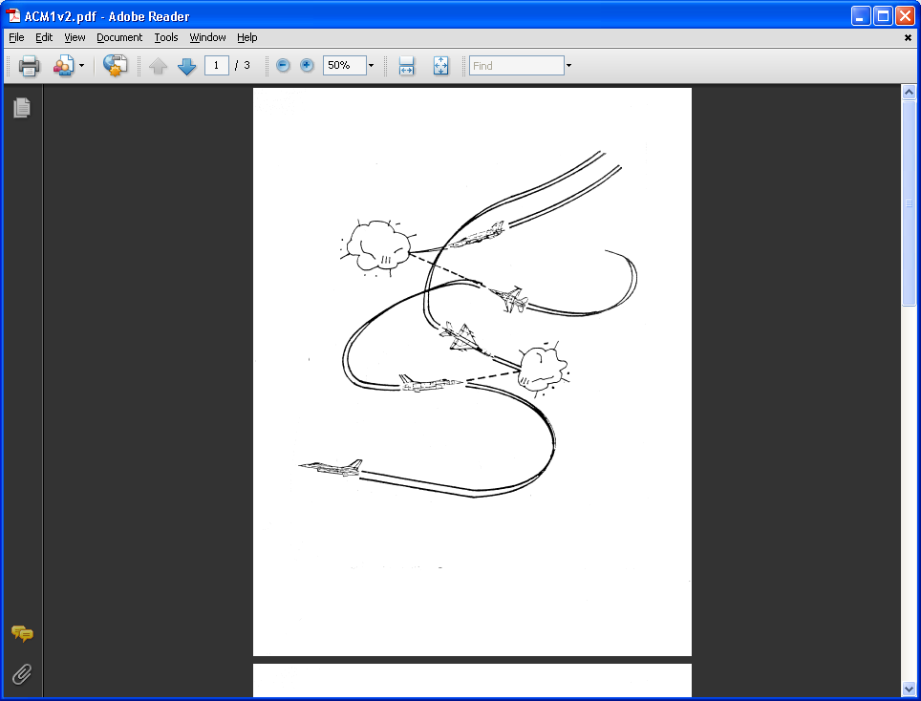
AE 317 Aircraft Flight Mechanics and Performance
Streamlines, Streamtubes, Continuity, Compressibility, and Euler’s
LECTURE 02
Dr. Jeff Ashworth
Aerospace Engineering Department

Slide 2
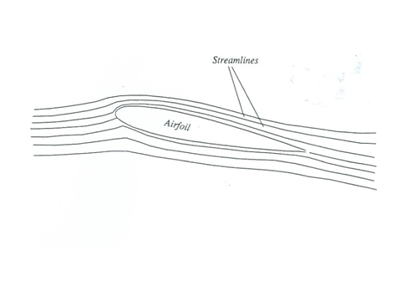
(Brandt)

Slide 3
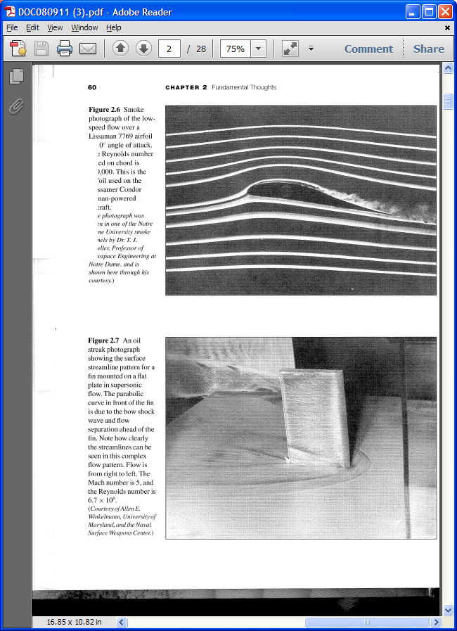
(Anderson)

Slide 4
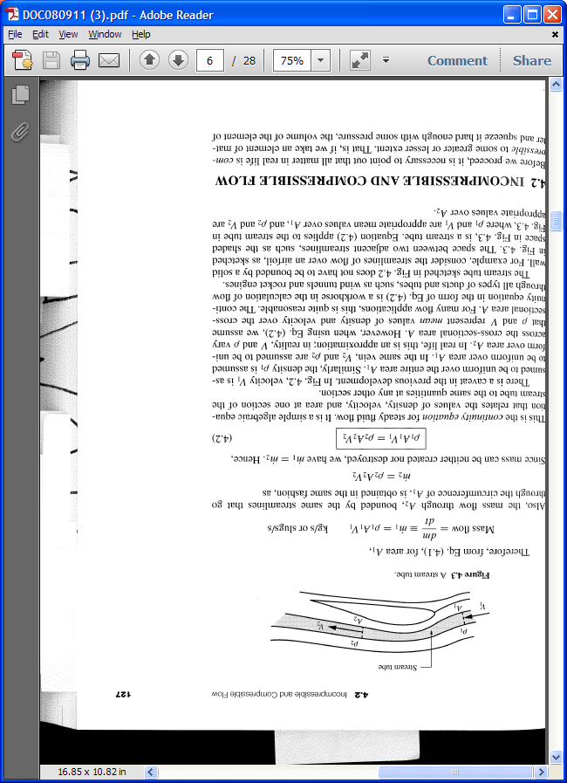
(Anderson)

Slide 5
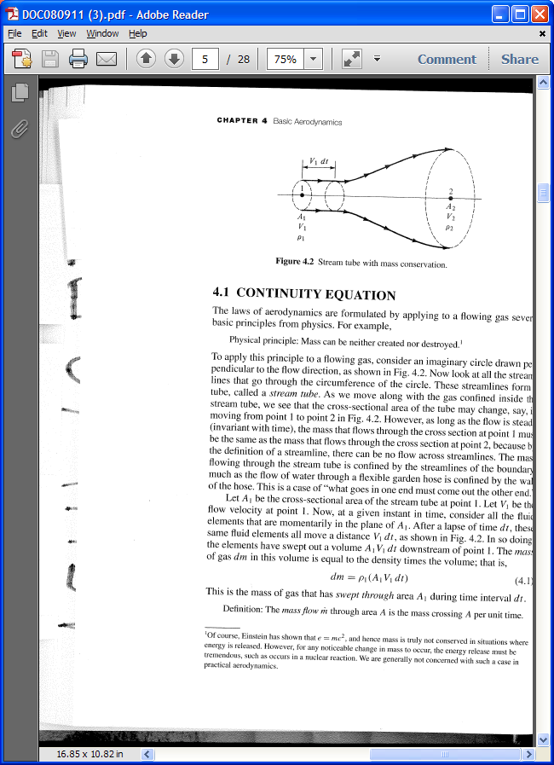
(Anderson)

Slide 6
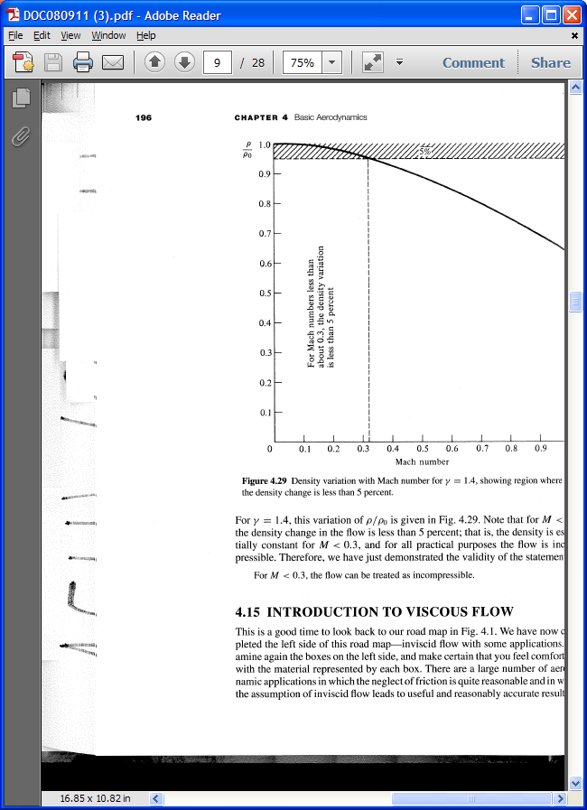
(Anderson)

Slide 7
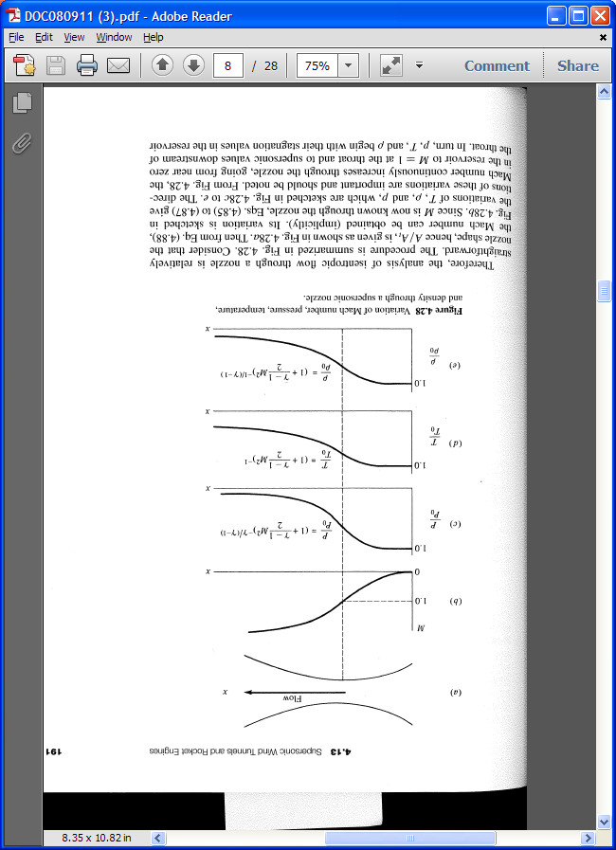
(Anderson)

Slide 8
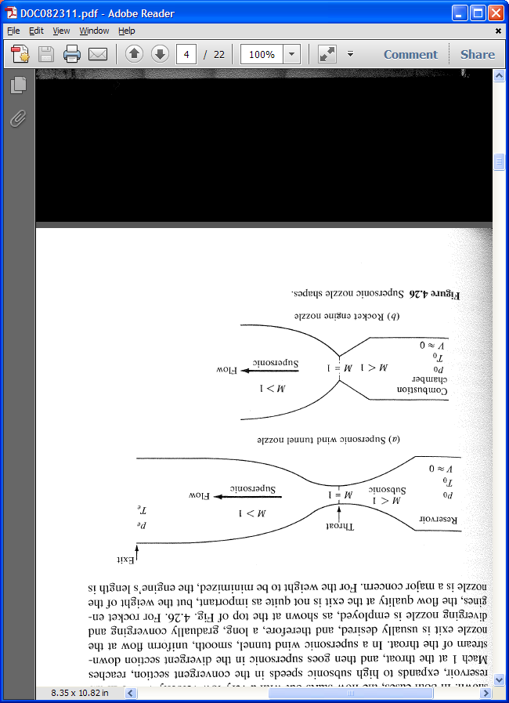
(Anderson)

Slide 9
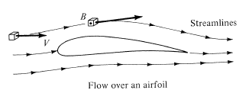
(Anderson)

Slide 10
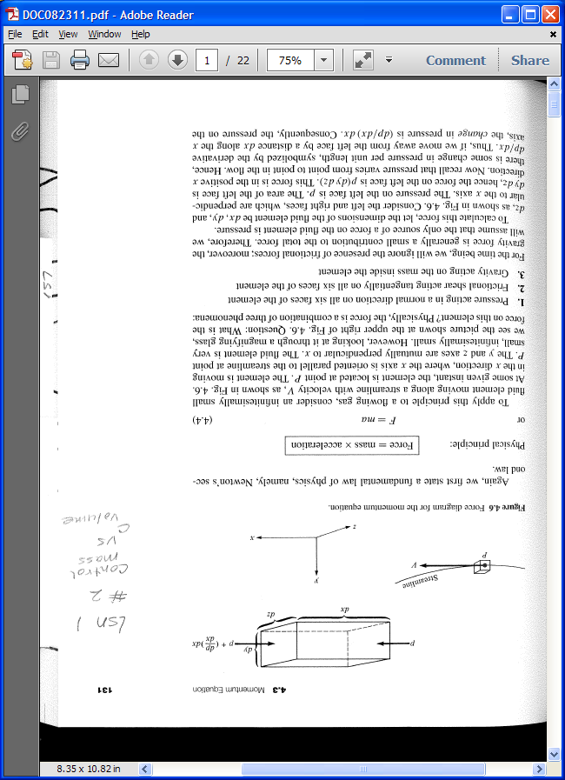
(Anderson)

